Slide 1
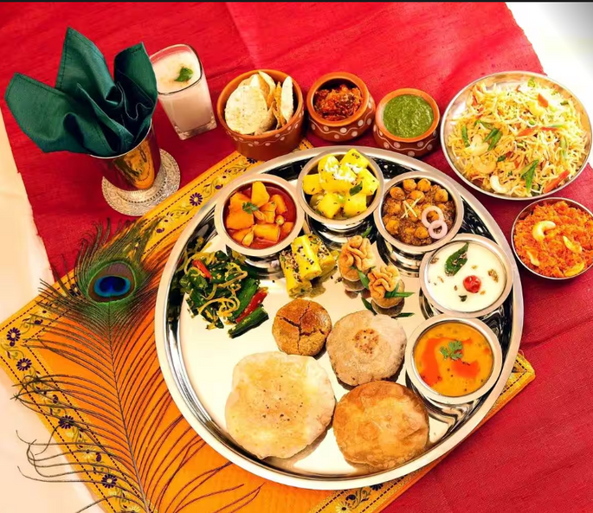











Anand Bhojanalay: The curious case of chronic attrition
Case Overview:
Six Branches with 120 Employees
Serving 550 customers regularly
Threat from catering business
Attrition During Wedding season
Problem Statement
Mr. Prakash Khatri, owner, faces a recurring challenge of attrition creating workforce shortages and affecting efficiency during the lucrative wedding season.
Cleaning Staff
Chef
Waiter
Dilemma?
What should be Mr. Khatri's hiring strategy so as to maximize monthly profit?
Manager
Security

Slide 2


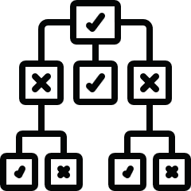

Data & Methodology
Data Collection: Interview & Past year data
Attrition data over the past 3 years
Retention rates over the past 3 years
Hike rates offered by Catering services
Simulation
Decision Tree
Cost Consideration
Round 1 : Employee Attrition
Round 2 : Employee Hike Rates
Round 3 : Employees Staying
Approach
Payoffs
Decisions

Slide 3
Insights
Nov
Dec
Jan
5
There's a 90% likelihood of a maximum extra cost of Rs. 89,396.47 in increments during the wedding season.
Best course of action is to not give Increments and go for a Limited hire policy to maximize average profits.
Cannot leverage hike in demand due to increased investment in salary increment during the season.
Capping salary increments based on industry standards to align with budget constraints.
4
3
2
1
0
Chef
Waiter
Cleaning staff
Forecasted attrition during the season
Cost of Increment
Salary of New hire Chef
Salary of New hire Waiter
Salary of New hire Cleaner
Impactful parameters
for decision-making

Slide 4








Recommendations
Establish a targeted increment budget of Rs. 27,750. Upon Exhaustion, initiate external hiring to maximize payoff.
Performance-based Incentives - Implement rewards for dedicated, high-performing staff in the wedding season.
Prioritize external recruitment to leverage hike in demand and divest investment from salary increment in short run.
Flexible Work Arrangements - Introduce flexible schedules to retain employees.
Transition chefs from non-contractual to contractual employment arrangements.
Referral Program - Attracts fresh talent and enhance engagement.
Examine more historical data to come up with accurate trend in demand growth as it is highly sensitive.
Temporary Benefit - Instead of pay raises, provide wedding season perks for retention.

Slide 5











Business Impact - Long run
Customer and Employee Loyalty
Maintains service quality, fostering loyalty and repeat visits.
Major Insight
Reduced Training Costs
Reduced staff turnover minimizes training expenses.
Strategic Stability
A stable staff enables focus on strategic growth endeavors.
Demand
Profit
Skill Development And Expertise
With time, staff acquire skills; which enhances efficiency.
Reduced Recruitment Challenges
Prioritizing employees enhances reputation, easing recruitment
Invest in existing Employees!

